Slide 1
Google Analytics AdMob App indexing
Avais Muhib ur Rasool 15-4289
Khadija Asim 15-4314
Hafsah Shehzad 15-4338

Slide 2
Google Analytics
How do you actually know how many visitors came to your application?
Where did they come from?
What they do once they enter your application?
Google analytics helps to measure, report and analyze the behavior of the user coming to your website.
‘Google Analytics is a freemium web analytics service offered by Google that tracks and reports website traffic, currently as a platform inside the Google Marketing Platform brand’ – Wikipedia

Slide 3
Why Google Analytics?
Google Analytics is a free tool!
Very useful from marketing point of view.
Provides an in-depth detail about the user
Which
Helps you track your marketing effectiveness.
For example, just knowing the total amount of people visiting your website is not very helpful to your business. Knowing how many people visit your website by age or location, on the other hand, is very helpful to figure out who your core audiences are on the internet.
You may learn, for instance, that 80% of your visitors are women between 25–35 in a particular area— that’s extremely useful and actionable information about who you should be targeting with your digital marketing.
That’s why over 50 million websites and applications around the world uses Google Analytics.

Slide 4
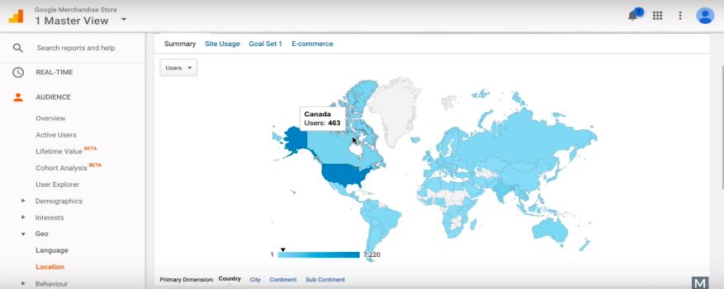
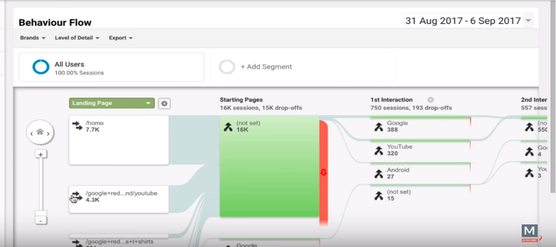
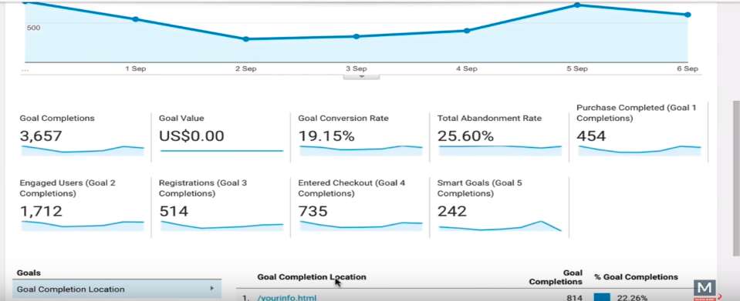
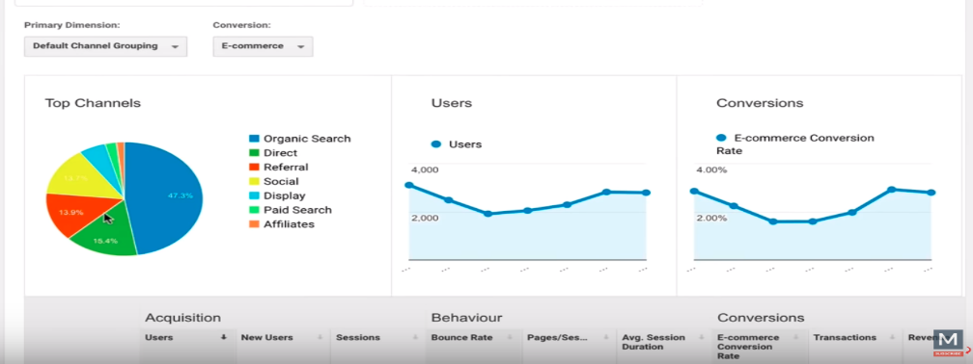
What kind of data are available on Google Analytics?
Audience Data
The technology the user is using.
Where is the user from etc.
User Acquisition Data
Data about your users before they visit your application.
You can access data about your user demographics before they visit your app (e.g. their age, gender, and interests).
You can also get data about where they are coming from, whether that’s Facebook, other websites/apps, or Google search.
User Behavior Data
Data about your users when they visit your app.
how long a user stayed on your website
what is their first and last page on your website
the most common pathway through which they go through your app
Conversion Data
Did the user take the actions that you desired him to take.

Slide 5
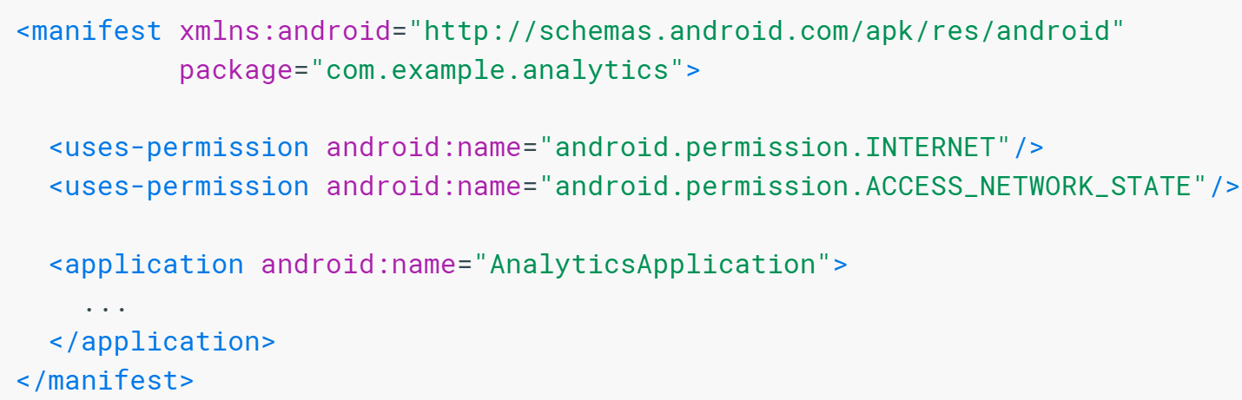
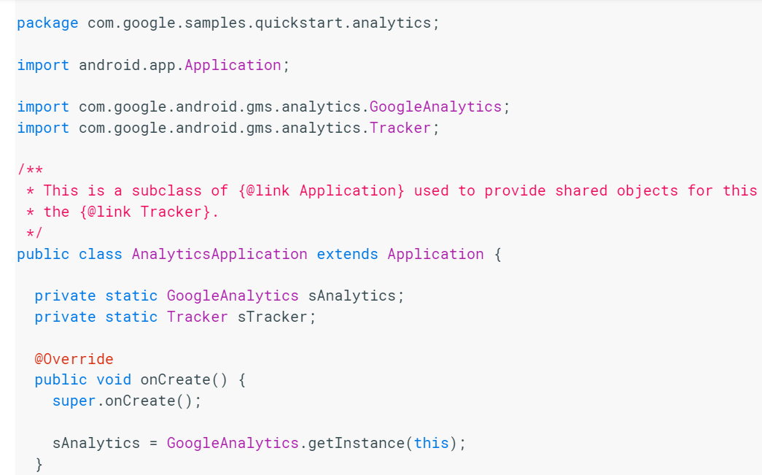
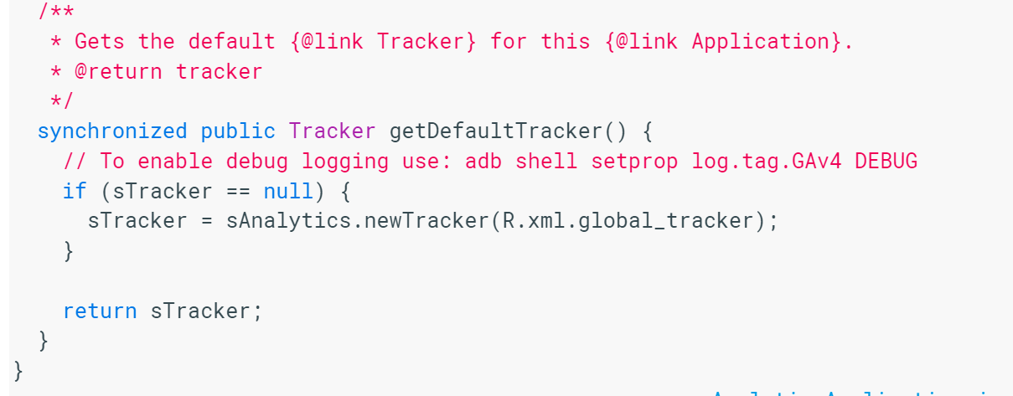
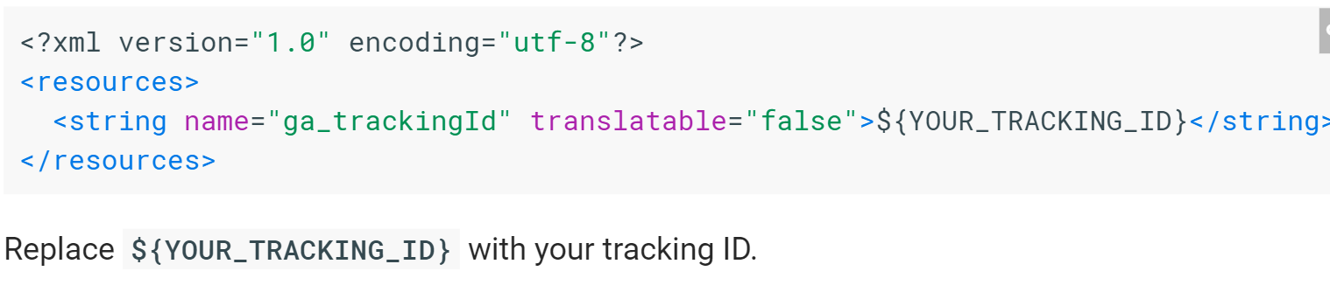
Use Google Analytics in your application
Update your project's AndroidManifest.xml file to include the INTERNET and ACCESS_NETWORK_STATE permissions:
Add the following dependency to your project-level build.gradle:
classpath 'com.google.gms:google-services:3.0.0'
Add the following dependency on Google Play Services to app/build.gradle:
compile 'com.google.android.gms:play-services-analytics:10.2.4'
Create the file app/src/res/xml/global_tracker.xml with the following content:
Add screen tracking
Provide the shared tracker via an Application subclass.
Override the callback method for the foreground activity.
Provide a name for the screen and execute tracking.
You should subclass Application and provide a helper method that returns your application's tracker.

Slide 6
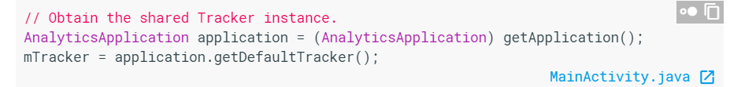
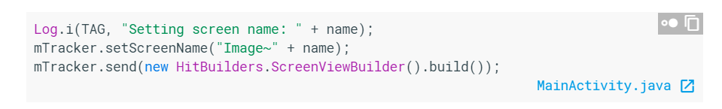
Open the Activity that you'd like to track. You could also track a Fragment, but ensure that it correctly represents a screen view.
Override the onCreate method of the Activity or Fragment you want to track to obtain the shared Tracker instance:
Override the appropriate method, such as onResume for an Activity or onPageSelected for a ViewPager to log when the screen changes.

Slide 7
ADMOB

Slide 8
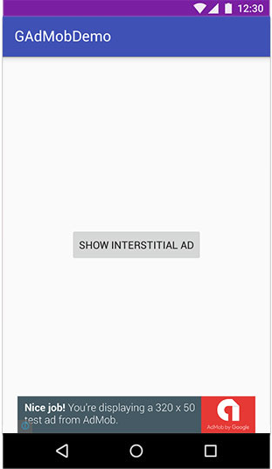
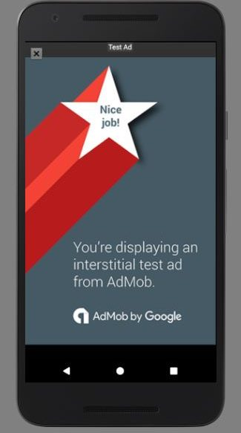
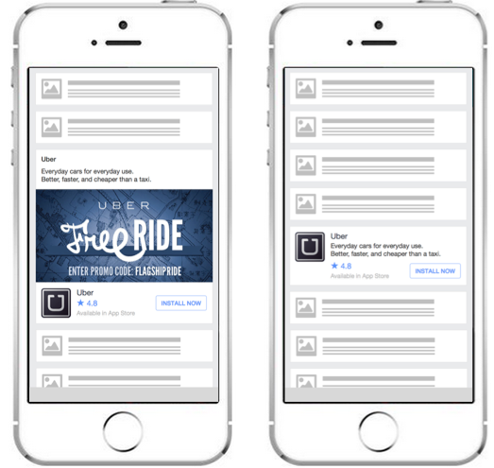
What is ADMOB
Mobile advertisement platform used to generate revenue from app
Available for Android and iOS platforms
Support for Unity gaming engines
Types of ads
Banner ads
Interstitial ads
Video ads
Native ads
Notes:
Google Analytics: Helps increase analytical capabilities (Scalability increases and improve user experience)
Ads can be customized to match the app theme
Scalability improvesby allowing you to expand your user base or implementing ads across multiple applications
Google analytics helps display app monetization reports

Slide 9
Integration with Firebase
Admob uses the Google Mobile Ads SDK
Integrates with Google Analytics
Allows access to reports about application
User acquisition
Revenue
Screen views
Allows segmentation of audience
Notes:
SDK helps users gain insight about their users and drive more in app purchases and maximize revenue
Does this by collecting information about the device information, ad info, purchase info etc
Google Analytics: Helps increase analytical capabilities (Scalability increases and improve user experience)
Ads can be customized to match the app theme
Scalability improvesby allowing you to expand your user base or implementing ads across multiple applications
Google analytics helps display app monetization reports

Slide 10
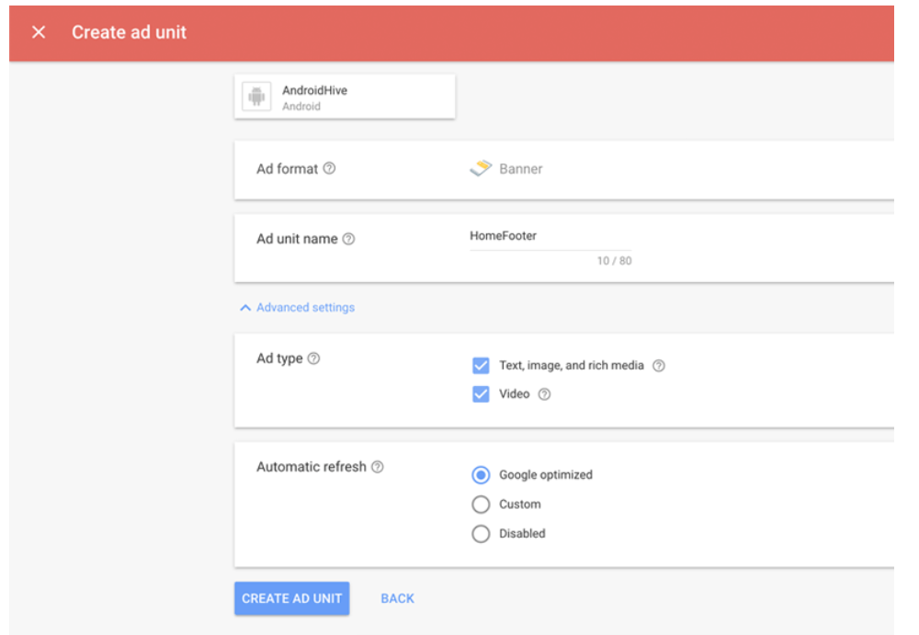
ADMOB INTEGRATION
Prerequisites
Install Firebase SDK
Create AdMob account and register your app
Create add units
Link app to Firebase project
Notes:
Register app ->APP ID
Create AD UNIT-> AD UNIT ID
AD UNIT ID= unique identifier given to the ad unit in your app where ads are to be displayed

Slide 11
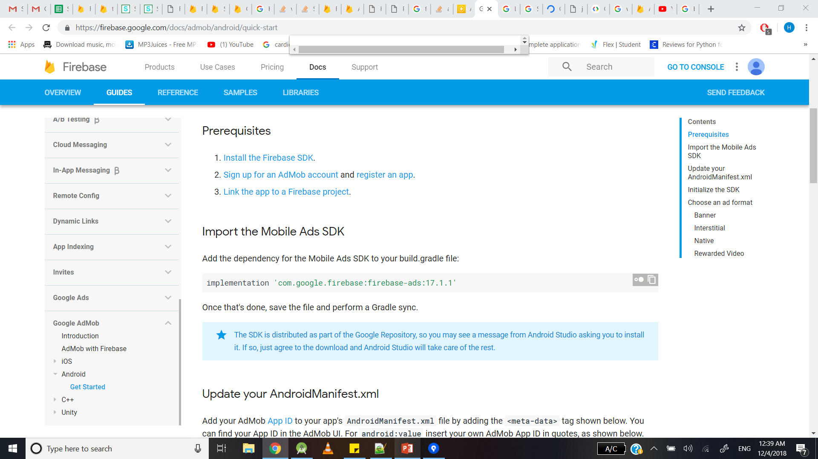
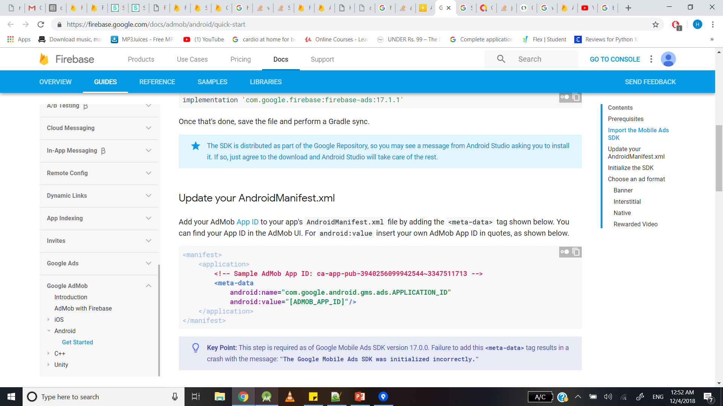
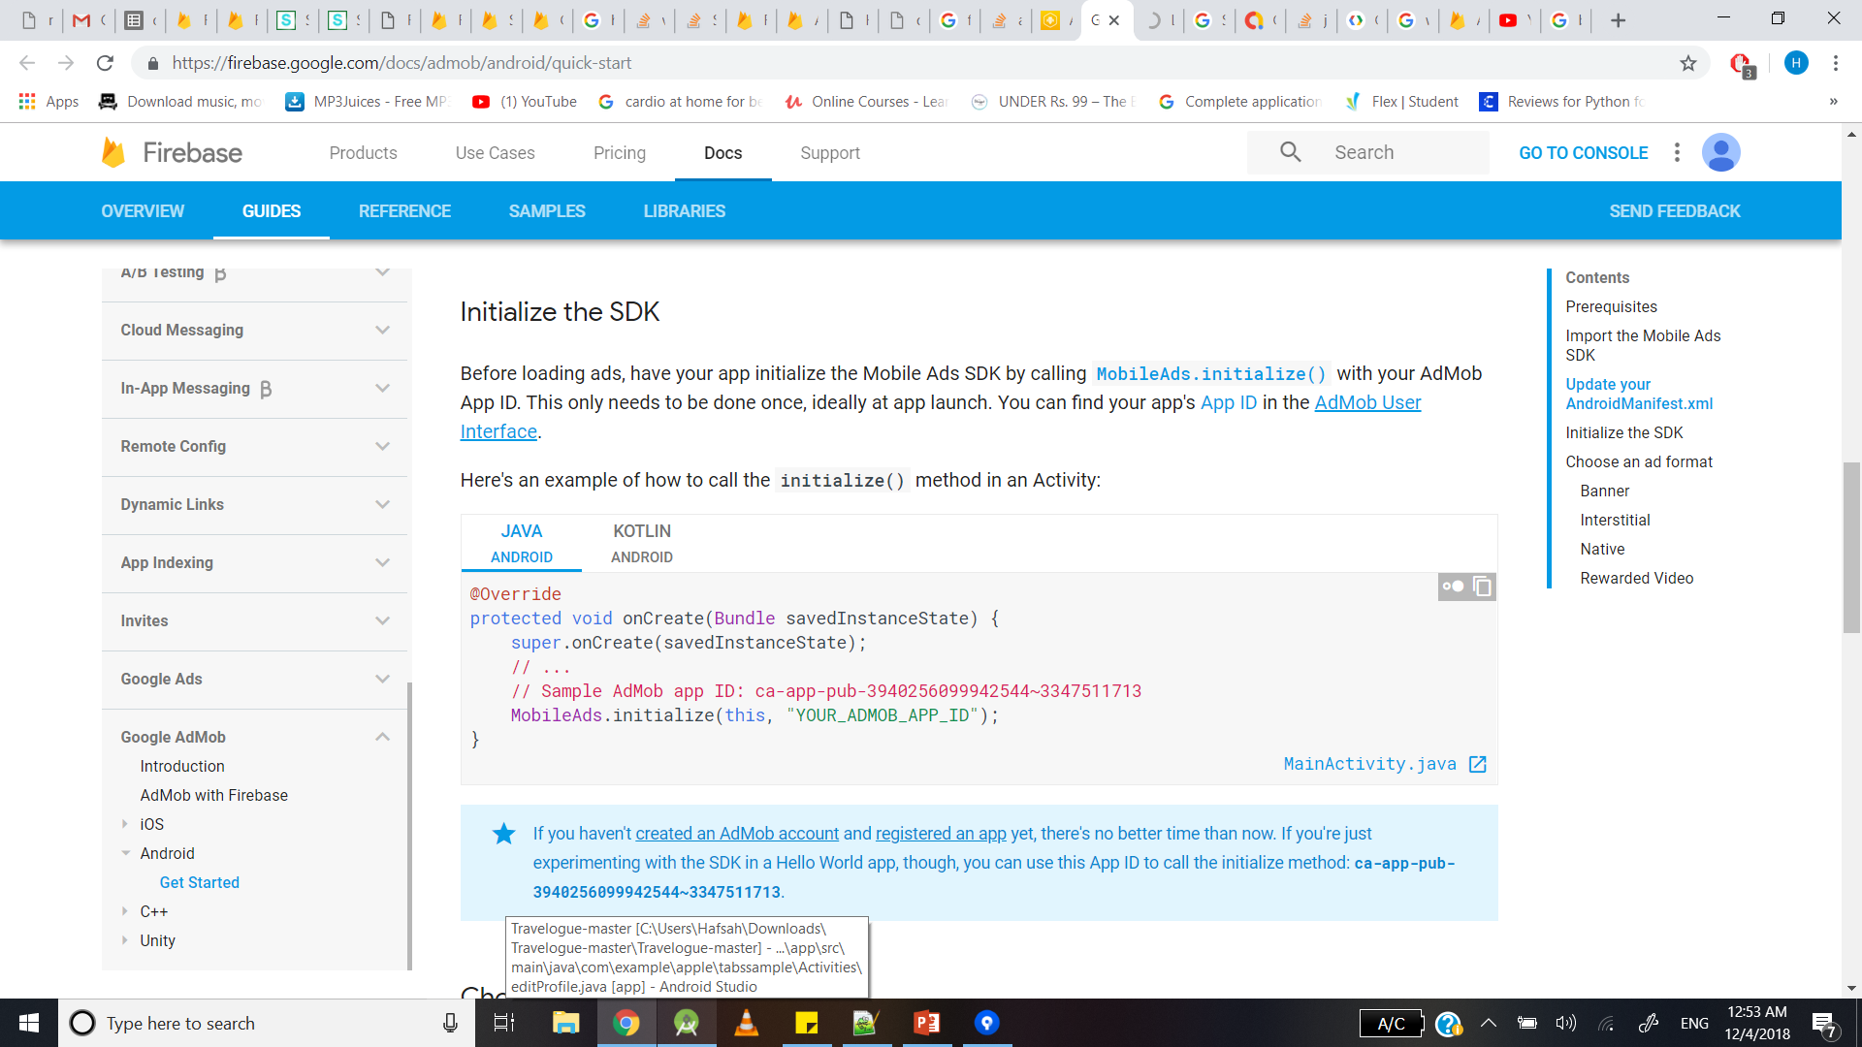
Import Mobile Ads SDK
Update Manifest
Initialize the SDK
Implement your ad

Slide 12
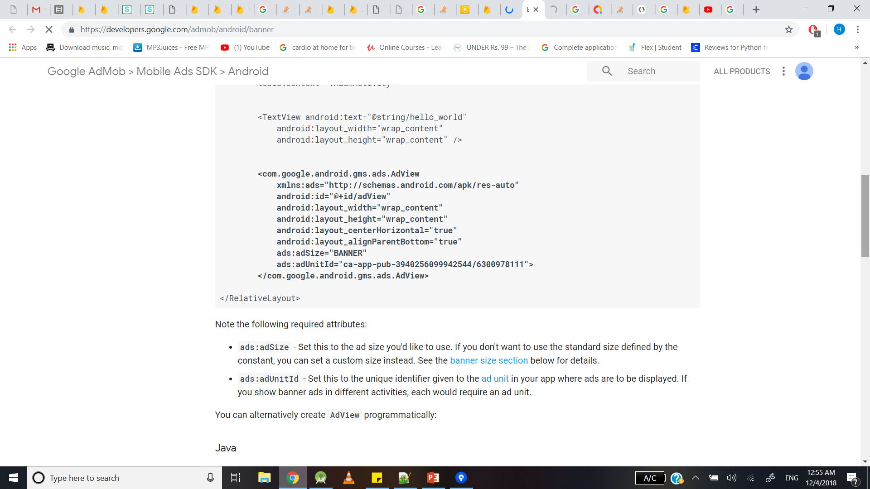
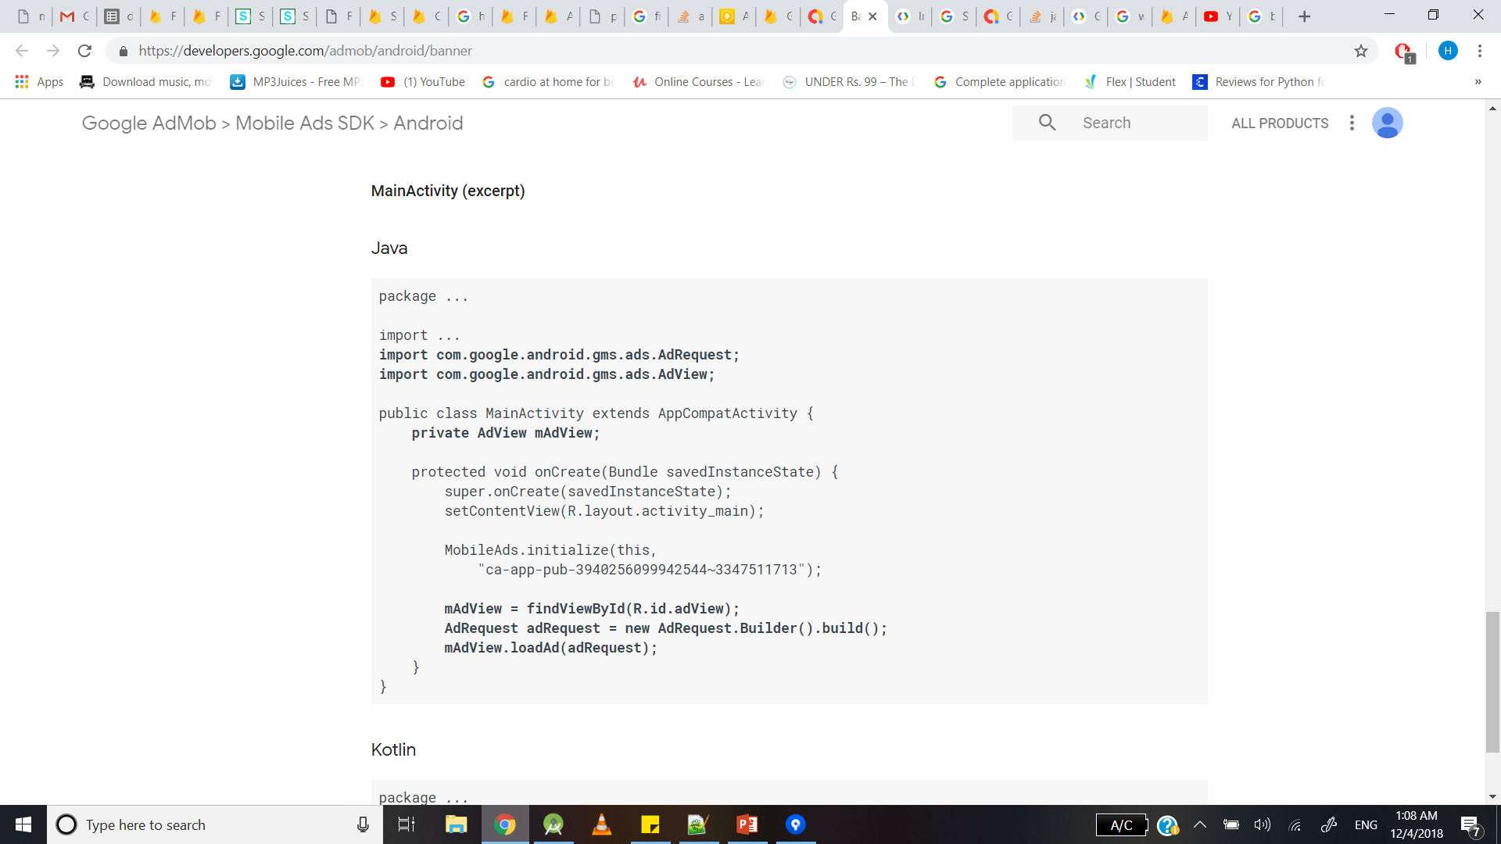
Banner
Set ad view
Load the ad

Slide 13
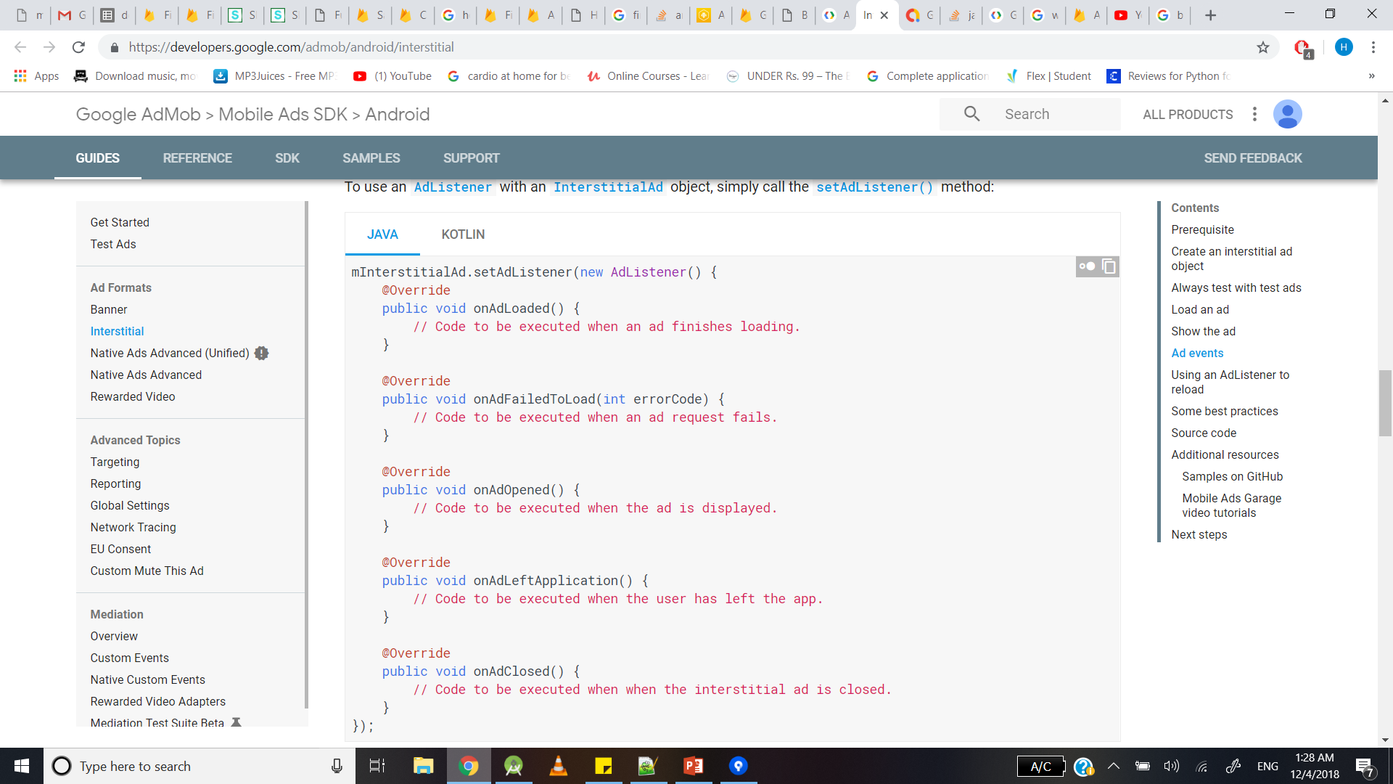
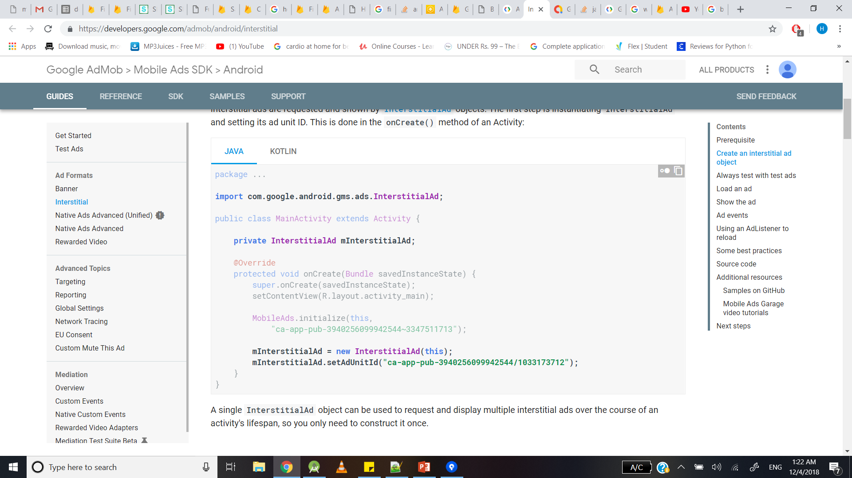
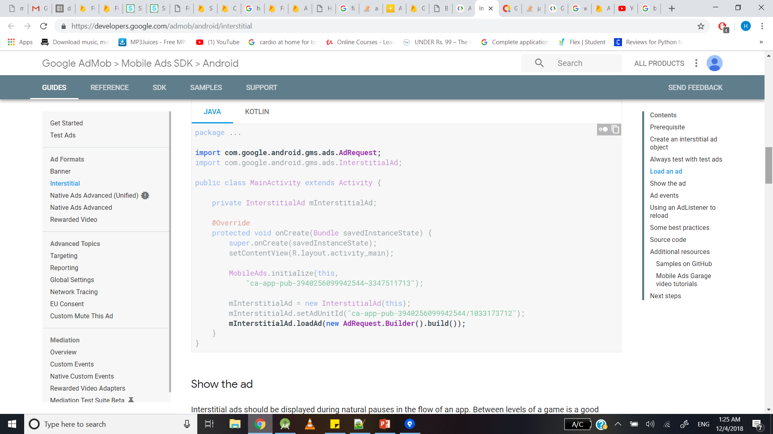
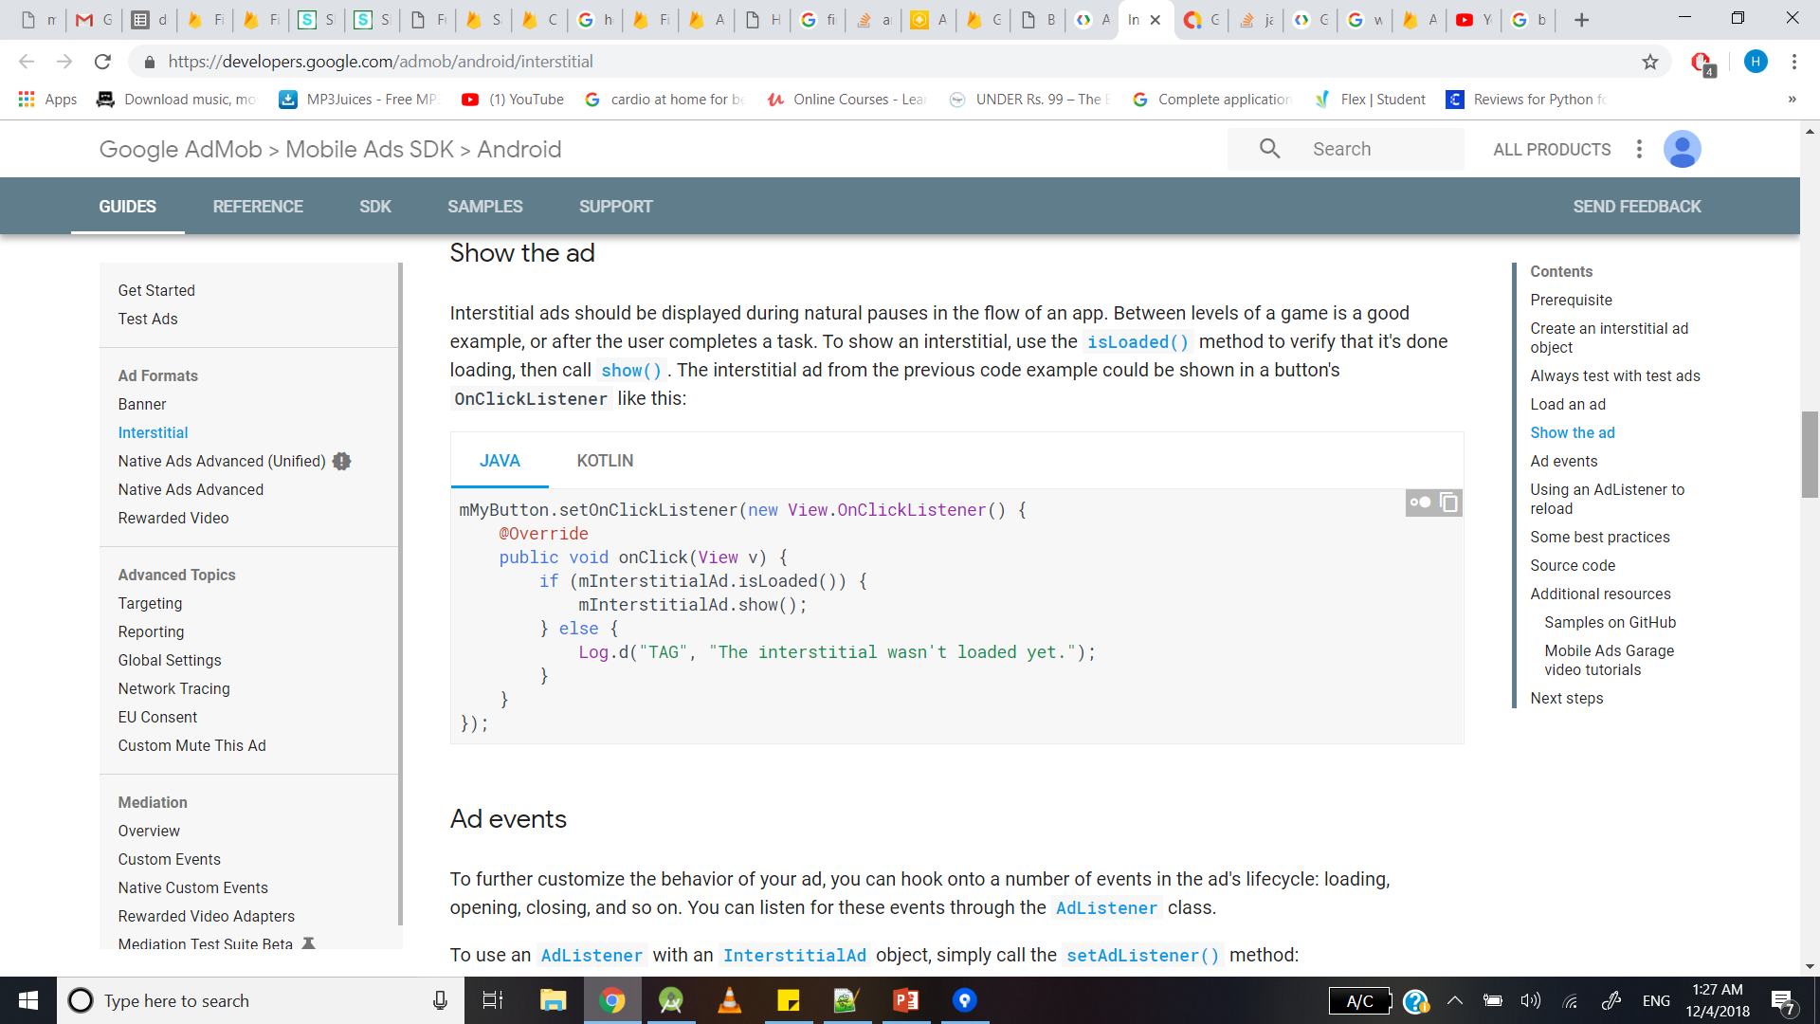
Create ad listener
Interstitial
Create Interstitial ad
Load ad
Show ad

Slide 14
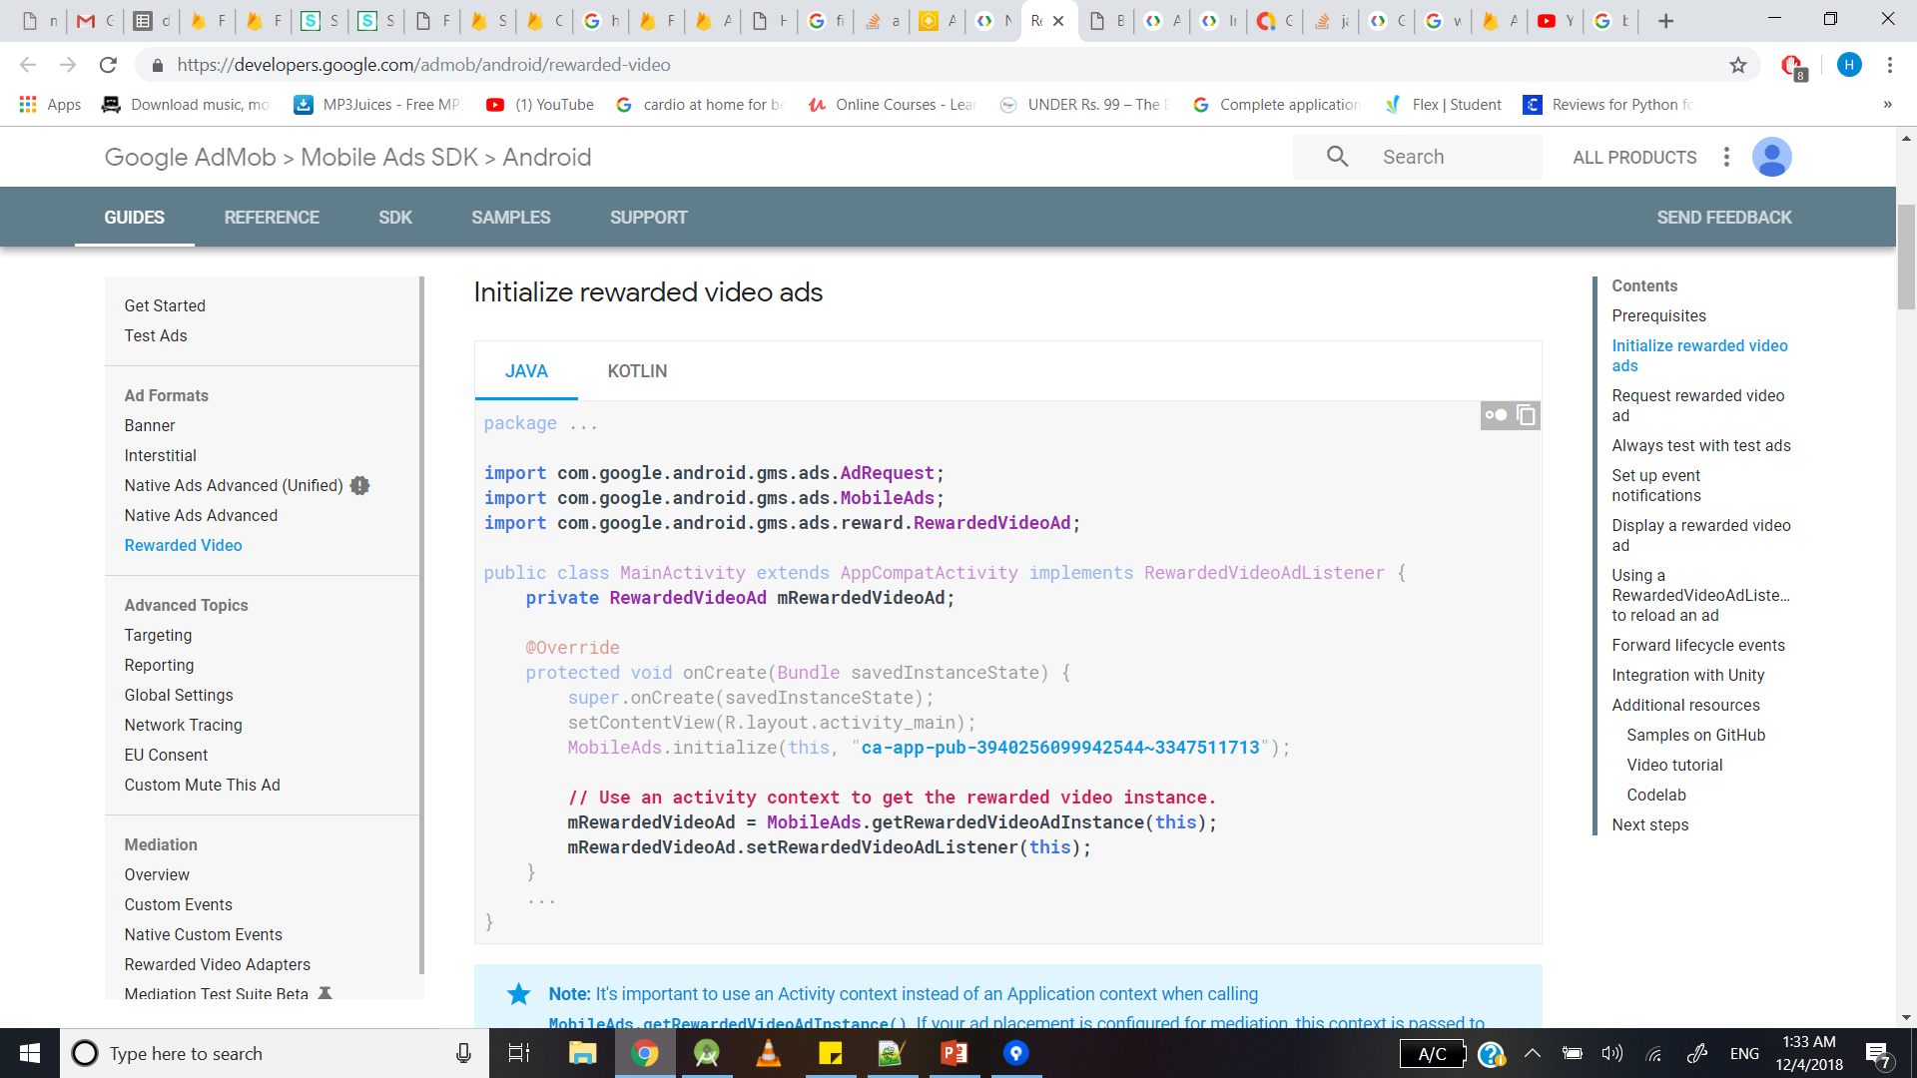
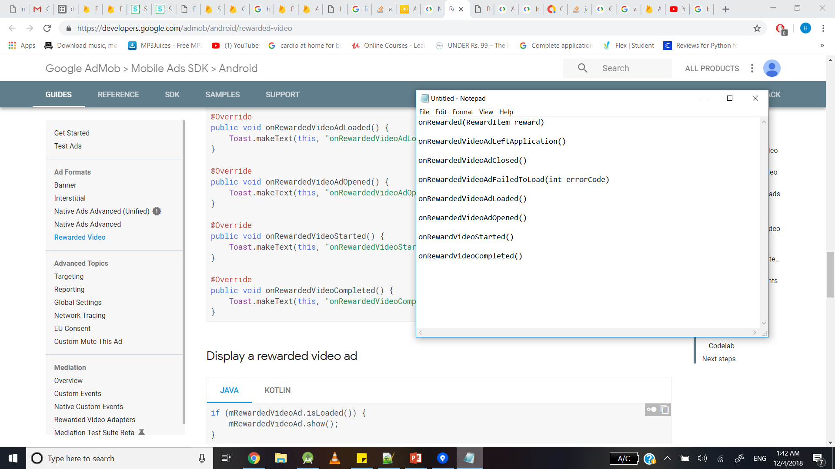
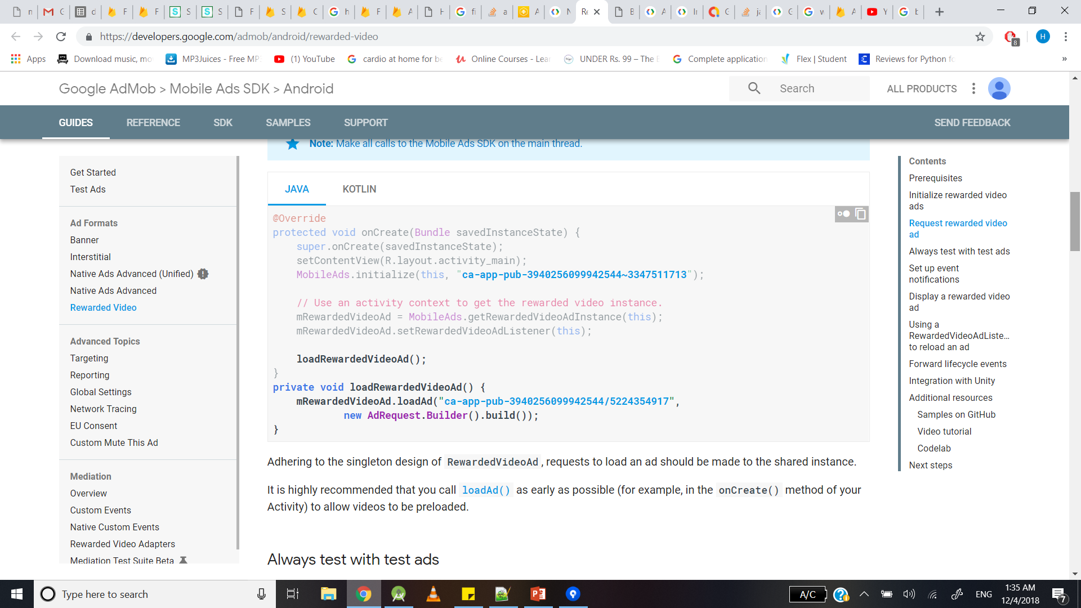
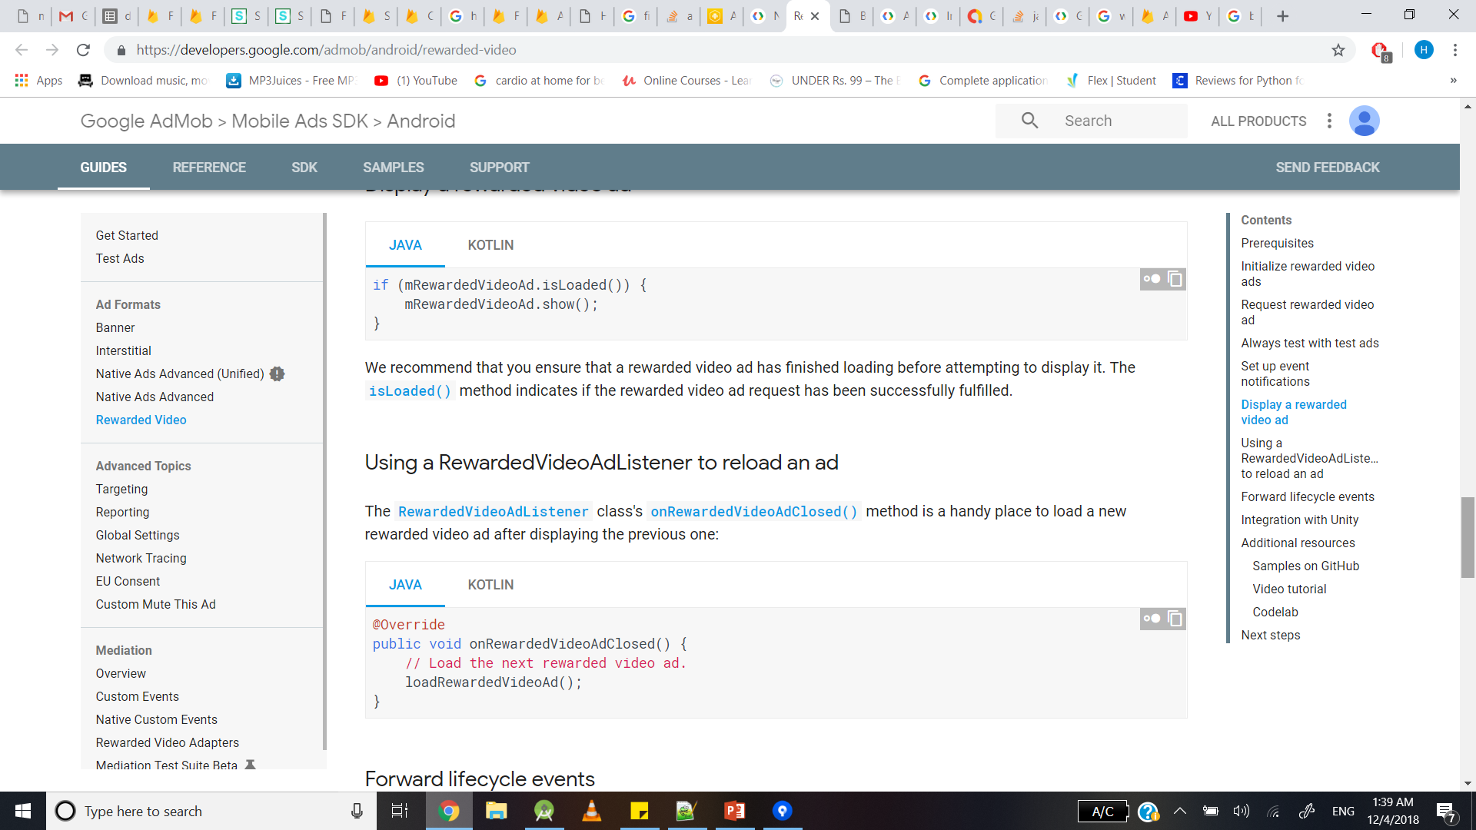
Video ad
setRewardedVideoAdListener
Create Video ad instance
Load ad
Show the ad
Notes:
Create a rewarded video ad
Load the ad
Set ad listener to prompt events
Show video ad just like you show the interstitial ad
Reload ad once its done(onRewardVideoAdCLoserd)

Slide 15
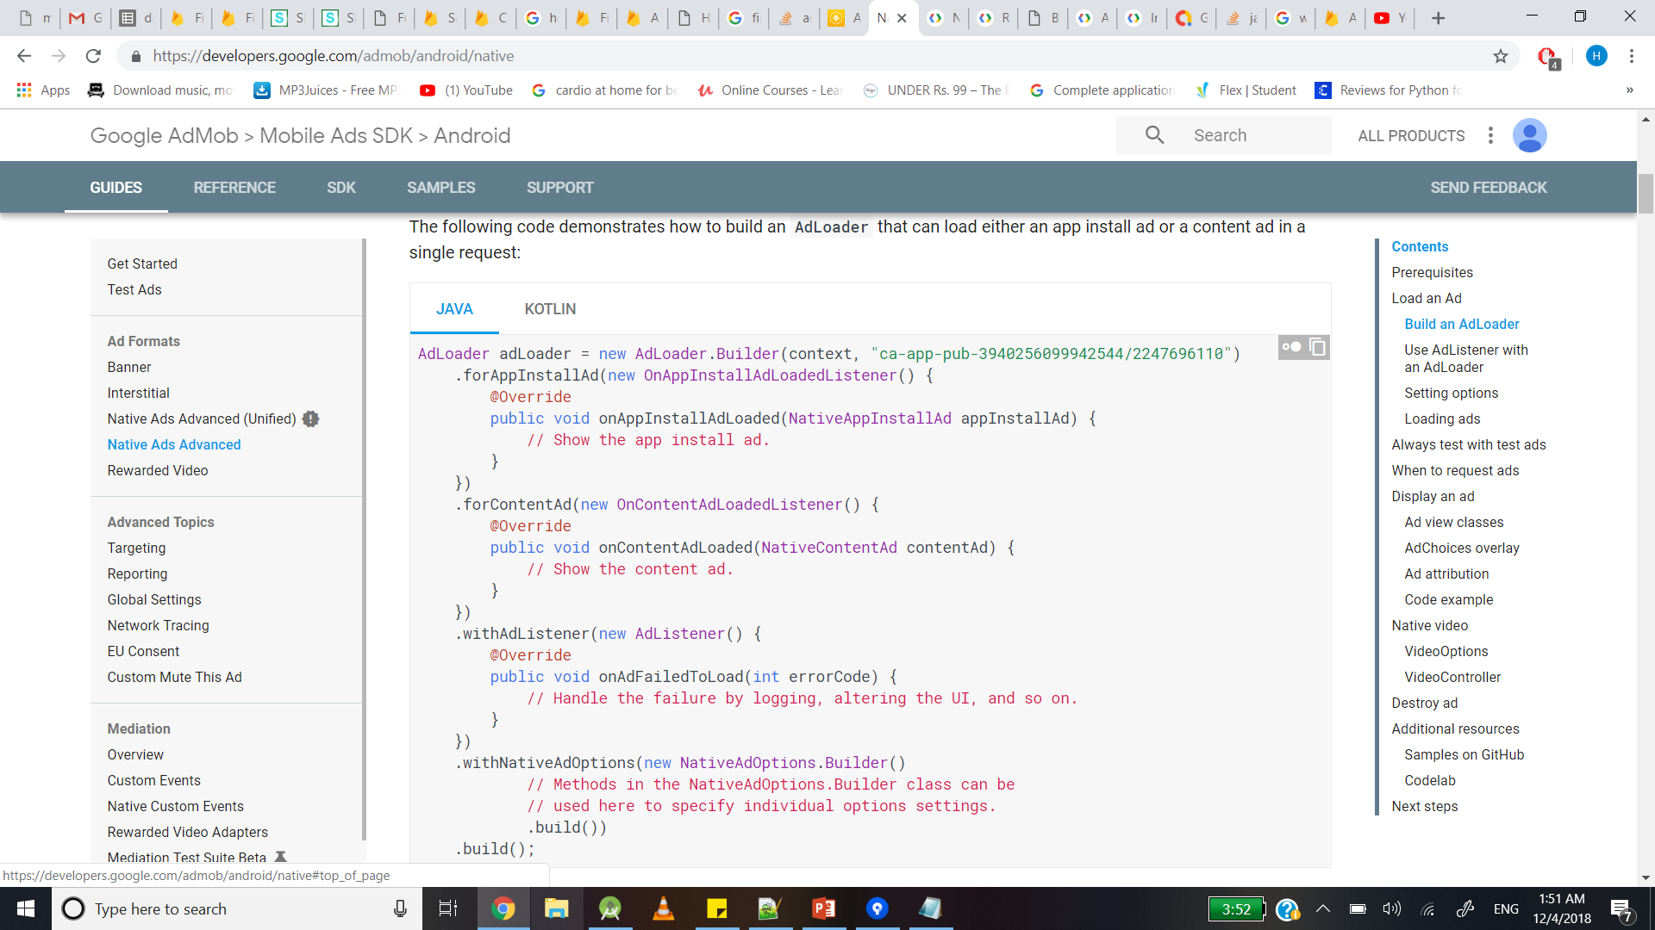

NativeApp Install Ad/Content Ad
Native options
set Image Orientation
set AdchoicesPlacement
setVideoOptions
Notes:
AdLoader has its own Builder class
Create listener
Native ad options->set Image orientation/ setAdchoicesPlacement

Slide 16
APP INDEXING

Slide 17
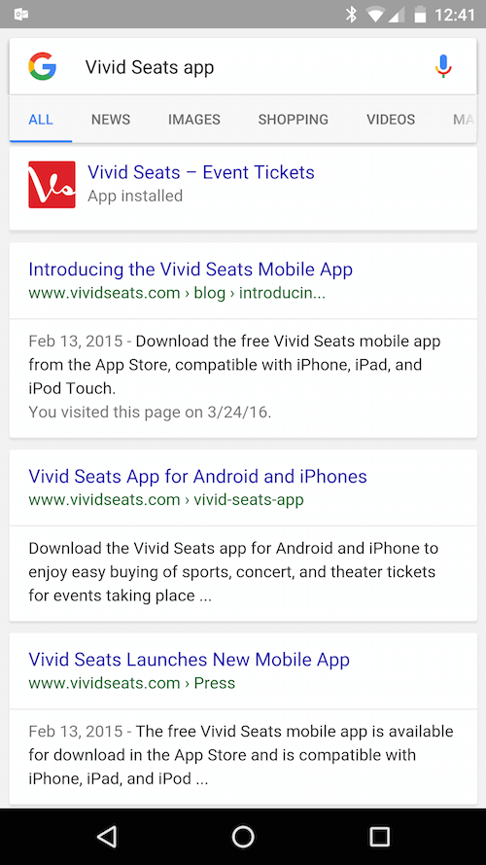
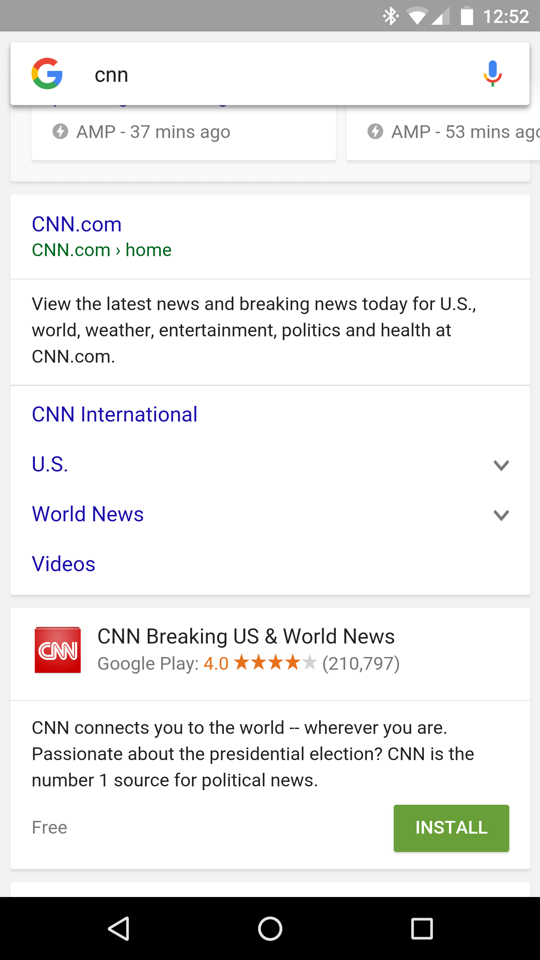
Google App Indexing is a system that allows people to click from listings in Google’s search results into apps on their Android and iOS smartphones and tablets.
By supporting HTTP URLs in your app and adding the App Indexing SDK, you allow Google to crawl and index your app as it would a web page, and you enable users to install or launch your app from search results when they search with relevant keywords.
App Indexing gets your app into Google Search. If users have your app installed, they can launch your app and go directly to the content they're searching for. App Indexing reengages your app users by helping them find both public and personal content right on their device, even offering query autocompletions to help them more quickly find what they need. If users don’t yet have your app, relevant queries trigger an install card for your app in Search results.

Slide 18
Re-engage your users from Google Search
Surface links to your app on Google Search autocompletions and results pages when users search content that your app provides.
Improve your ranking on Search
Integrating your app with the App Indexing API enhances the ranking performance for links to your app on Google Search.
Get discovered by new users
New users see an install card for your app in Search results when relevant queries trigger. They can always access your app content from Search if it's an Android Instant App.
Increase revenue with better in-app ad targeting
App Indexing and AdMob work together to improve the relevance of ads shown in your app, helping to drive increased advertising revenue.

Slide 19
Add Intent Filters

Slide 21
Associate your App and Website

